Slide 1

Daily Mood Tracker Dairy with Thoughtful UI
Name : Venigalla Kiranmai
Internship : BlackBugs
Domain : Mobile Application Development

Slide 2

Introduction :
This project is a mobile application
It helps users track their daily mood
Users can write personal diary entries
It improves mental well-being

Slide 3
Objective :
To develop a user-friendly mobile app
To track daily emotions
To store diary entries
To analyze mood patterns

Slide 4
Problem Statement :
People do not track their daily emotions
No simple app combining mood + diary
Difficult to analyze emotional patterns

Slide 5
Solution :
Developed a mobile app for mood tracking
Simple emoji-based mood selection
Diary writing feature
Visual analytics using charts
😊 😢 😡 😃 😴 😐

Slide 6
Key Features :
Mood Tracking (emoji-based)
Daily Diary Entries
Mood Analytics (charts)
Calendar View
Thoughtful UI Design

Slide 7
System Architecture :
User interacts with mobile app
App stores data in database
Data used for analytics

Slide 8
Workflow :
User logs into app
Selects daily mood
Writes diary entry
Data is stored
Analytics generated

Slide 9
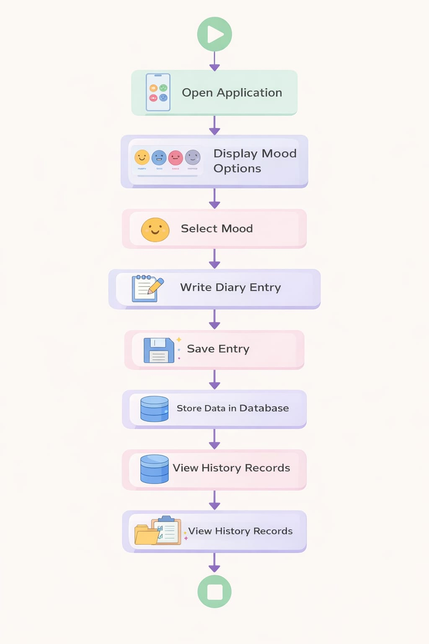

Slide 10
Source Code Overview :
Developed using HTML, CSS, and JavaScript
Frontend-based mobile/web application
Uses localStorage for data storage

Slide 11
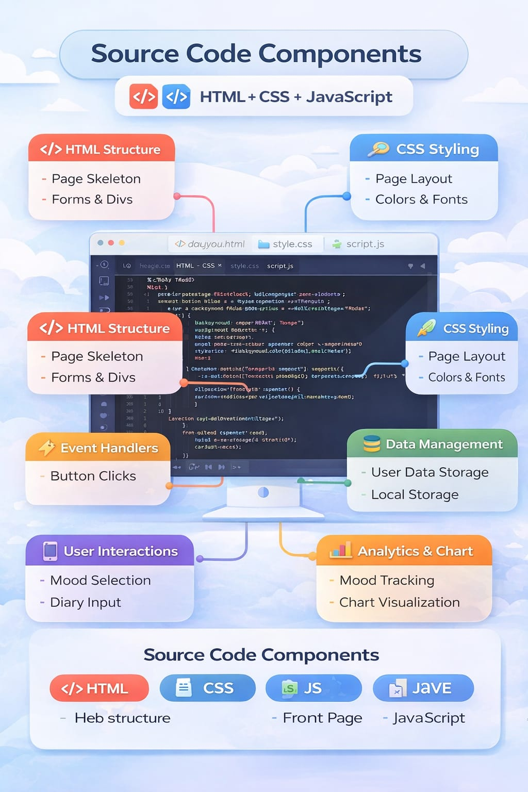

Slide 12
Includes multiple modules :
Login
Mood Selection
Dairy Entry
History
Analytics

Slide 13
Login Module :
User enters username and password
Basic validation is applied
Data stored using localStorage
Redirects to welcome page

Slide 14
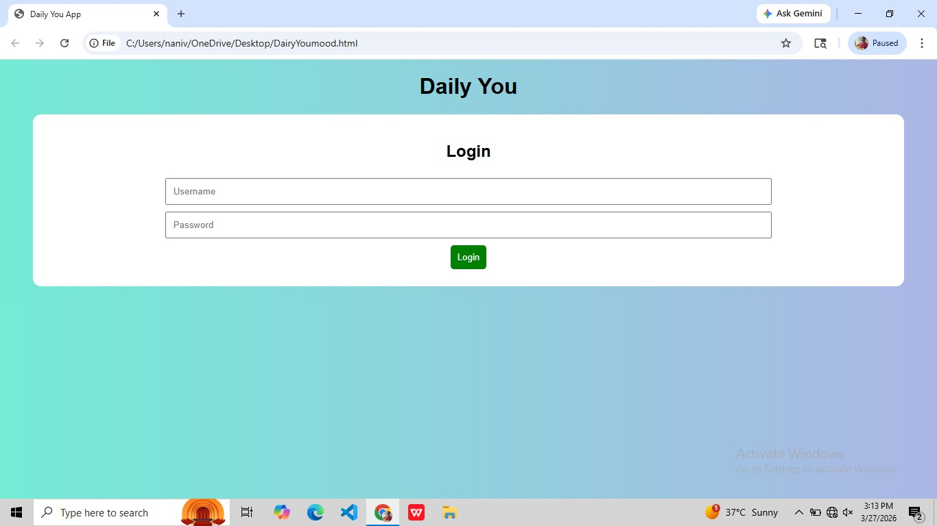

Slide 15
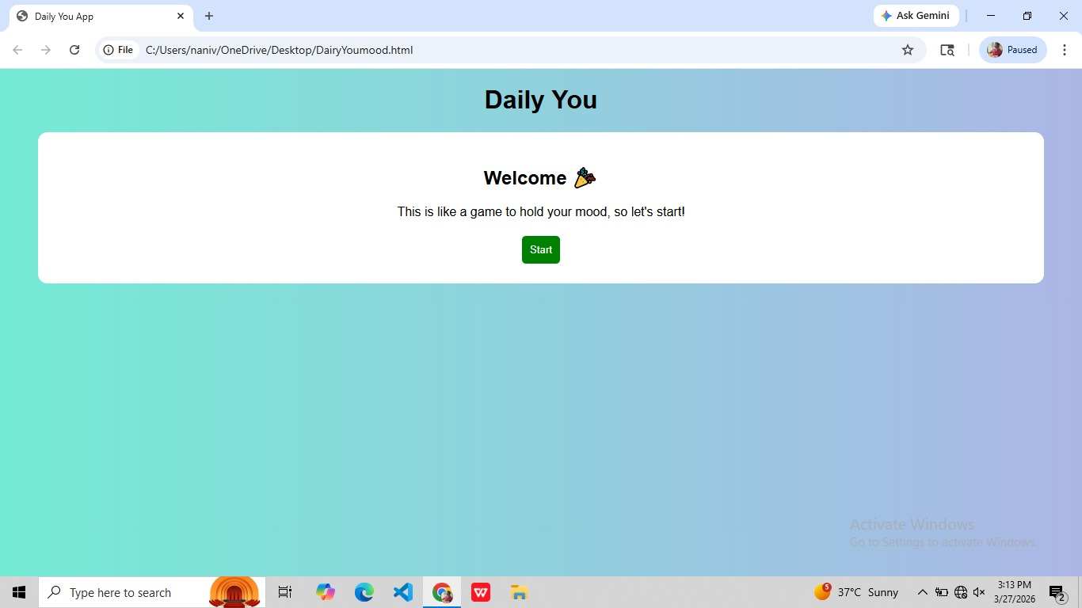

Slide 16
Mood Selection Module :
User selects mood using buttons
Moods include:
Happy, Sad, Angry, Excited, Tired, Neutral
Selected mood stored temporarily

Slide 17
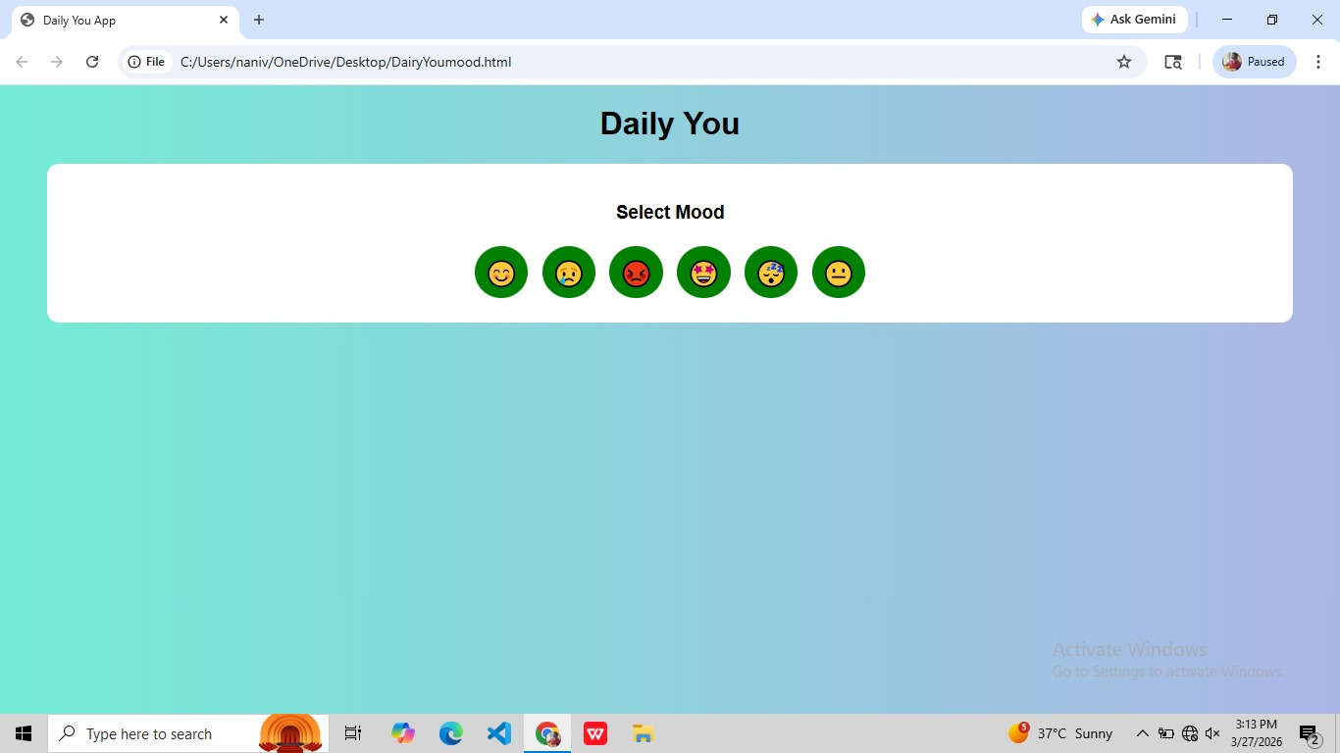

Slide 18
Dairy Entry module :
User writes daily thoughts
Entry includes:
Username
Mood
Text
Date
Data stored in localStorage

Slide 19
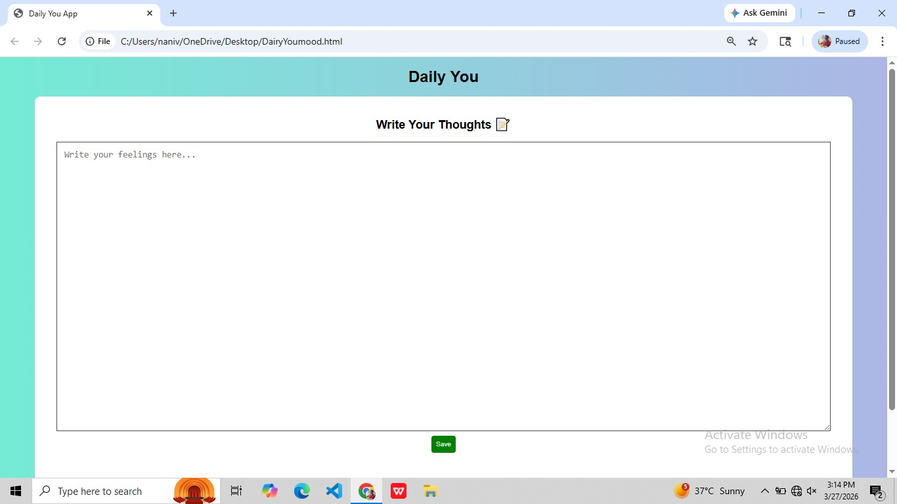

Slide 20
History Module :
Displays previous entries
Shows mood history
Data retrieved from localStorage

Slide 21
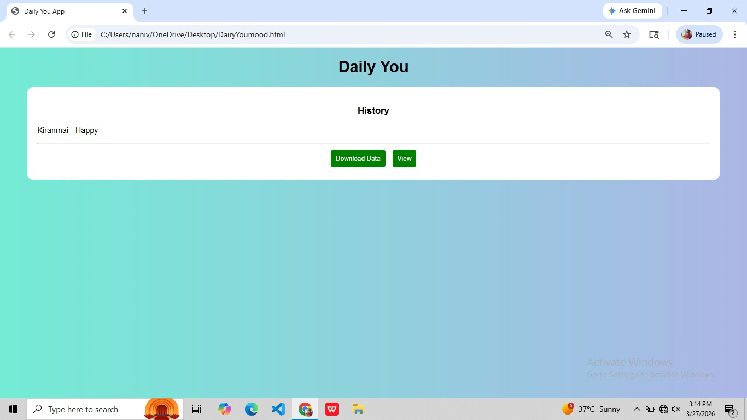

Slide 22
Analytics Module :
Displays mood data using chart
Counts frequency of each mood
Uses HTML canvas for visualization

Slide 23
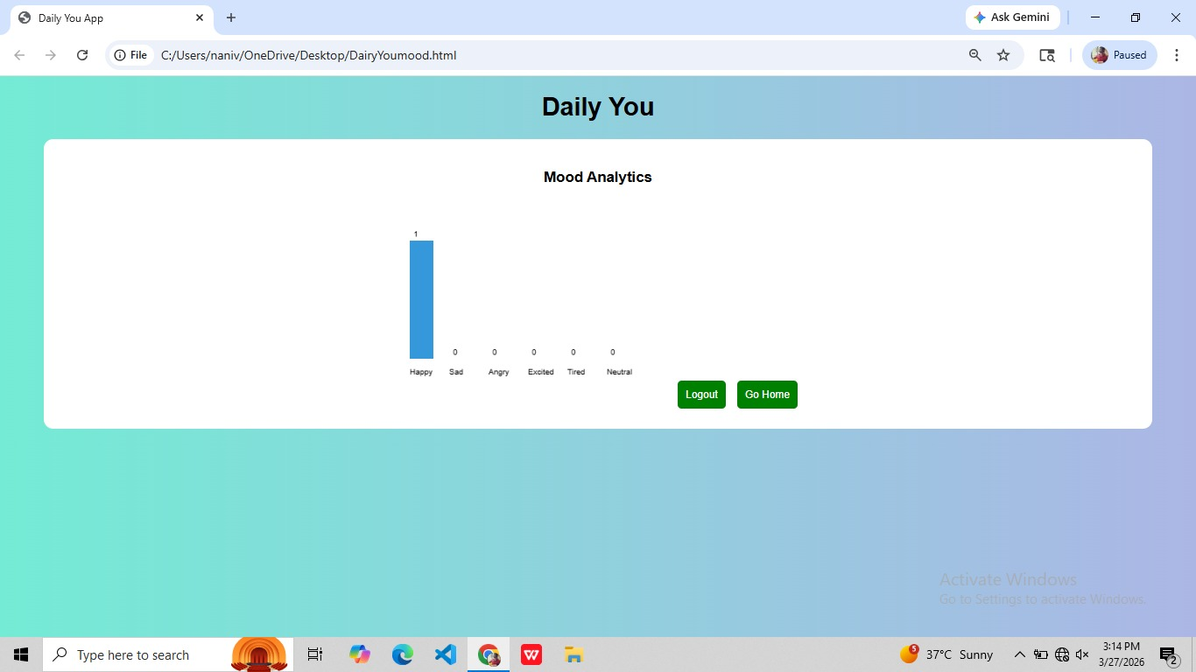

Slide 24
Data Storage :
Uses browser localStorage
Stores data in JSON format
Easy retrieval and update

Slide 25
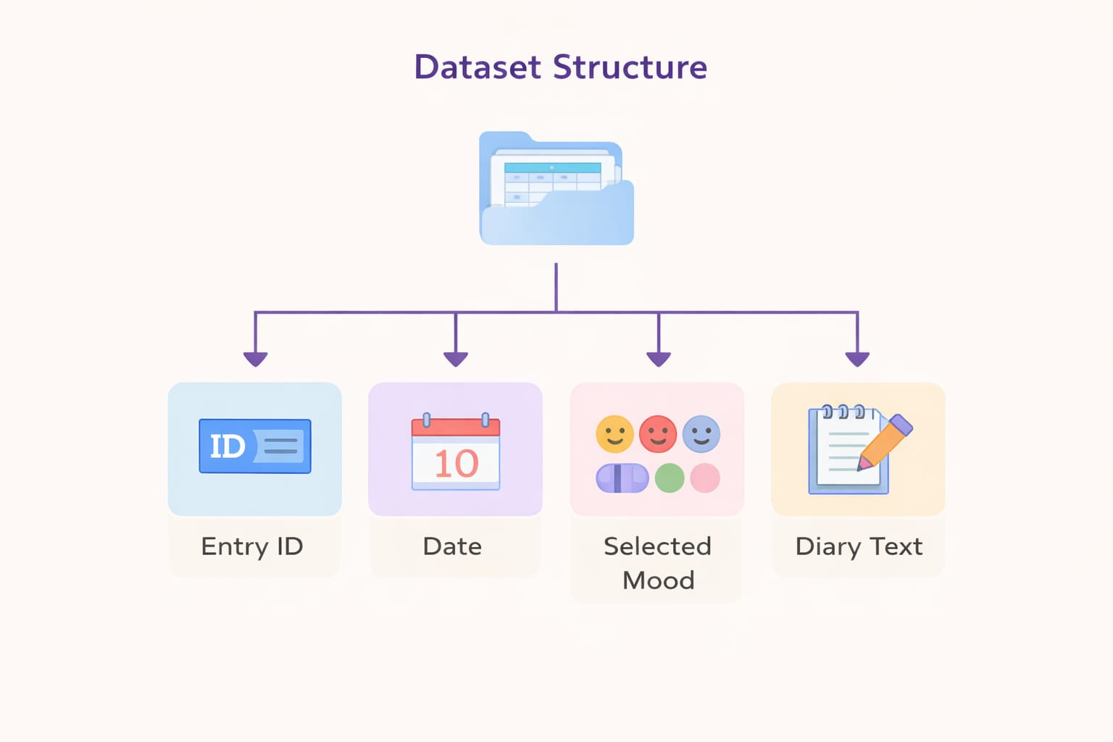

Slide 26
Conclusion :
Successfully developed mood tracking app
Helps users manage emotions
Useful for daily life and mental health

Slide 27
Thank You - Any Questions

